Slide 1
SkillGenome X
AI That Maps a Nation’s True Skill DNA Using Fragmented & Adversarial Data
Team Name :
Member Names:
SHAHVEZ KHAN
SHABAB FATIMA

Slide 2
Problem Background
Degrees
CGPA
Surveys
❌ Fail to capture real, ground-level skills ❌ Ignore informal, rural, and non-traditional talent ❌ Cannot predict future skill dynamics
➡️ Result: Traditional skill planning is inaccurate and reactive.

Slide 3
Objective
Design an AI system that reconstructs a Nation’s Skill Genome using:
Unconventional data
Noisy & fragmented sources
Adversarial signals (bots, fake engagement)
The system must:
Infer hidden skills
Detect regional talent clusters
Forecast future skill trends
Support policy and planning decisions

Slide 4
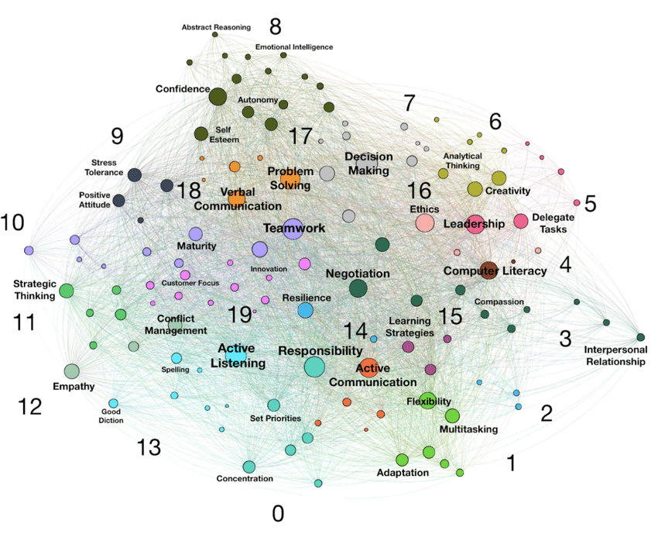
Why “Skill Genome”?
A Skill Genome is:
A multi-layer representation of skills
Similar to DNA: interconnected, evolving, and hierarchical
It captures:
Core skills
Emerging skills
Declining skills
Regional specializations
Cross-domain synergies
Pic source:Research Gate

Slide 5
Key Challenges
Fragmented data across platforms
Informal and undocumented skills
Regional imbalance in visibility
Adversarial data (bots, spam, fake profiles)
Dynamic nature of skills over time
➡️ Requires robust AI + graph intelligence

Slide 6

Input Signal Sources
The system ingests heterogeneous data such as:
GitHub & open-source activity
Anonymous coding/problem-solving forums
Citizen innovation labs
Rural & grassroots entrepreneurship
Gig-economy & online learning patterns
Cultural creativity & craftsmanship
Patent adjacency graphs
Skill diffusion across regions
pic source:https://upload.wikimedia.org/wikipedia/commons/4/49/India_-_Varanasi_girl_selling_flowers_-_0911.jpg

Slide 7
Proposed System Architecture
Four-Layer AI Architecture:
Data Ingestion Layer
Signal Cleaning & Adversarial Filtering Layer
Skill Intelligence Engine
Visualization & Policy Interface

Slide 8
Data Ingestion & Preprocessing
APIs, web scraping, open datasets
Multilingual text normalization
Time-stamped skill events
Regional tagging (geo-mapping)
Techniques:
NLP preprocessing
Feature extraction
Entity resolution

Slide 9
Adversarial Signal Filtering
Purpose: Remove fake or manipulated signals
Methods:
Bot detection using behavioral patterns
Graph anomaly detection
Outlier analysis
Trust-score assignment per source
Result: ✅ Clean, reliable skill signals

Slide 10
Skill Intelligence Engine
Core AI models used:
Graph Neural Networks (GNNs) → Skill relationships
Topic Modeling (LDA/BERT) → Skill discovery
Time-Series Forecasting → Skill evolution
Clustering Algorithms → Regional hubs
Output:
Hidden skill structures
Cross-domain synergies

Slide 11
Inferring Hidden Skill Structures
AI uncovers:
Non-obvious talent (e.g., rural robotics)
Informal skills not captured in resumes
Skill adjacency patterns
Example:
Agriculture + IoT + Automation → Smart Farming Cluster

Slide 12
Impact & Use Cases
Evidence-based policy making
Smart education planning
Workforce reskilling
Regional development
National AI-driven talent strategy

Slide 13
Conclusion
SkillGenome X transforms: ❌ Static education metrics ➡️ Into a living, evolving traditional skill intelligence system
It enables:
Visibility
Prediction
Prevention
Strategic growth

Slide 14
Thank You
Questions?

